Slide 1
COMPLEXITY THEORY

Slide 2
SPACE COMPLEXITY: how much memory an algrithm needs
TIME COMPLEXITY: how much time an algortihm needs

Slide 3
TIME COMPLEXITY: how much time an algortihm needs
how to measure absolute time?
a new computer will be faster of course
  than an old computer
super computers VS smartphones
SOLUTION: we consider number of steps
It is generic, machine independent etc...

Slide 4
12
2
6
8
1
For analyzing algorithms we have to consider the number
of items or the „input size”
Sorting 10 items → 100 ms
Sorting 1000 items → 1000 ms

Slide 5
12
2
6
8
1
For analyzing algorithms we have to consider the number
of items or the „input size”
Sorting 10 items → 100 ms
Sorting 1000 items → 1000 ms
IMPORTANT we want to make a good guess how the algorithm’s running time
depends on the number of items ( input size )
~ this is the order of growth: how the algorithm will scale and behave
with the input size

Slide 6
For example: we want to make sure that we end with a
sorting algorithm where the algorithm is
approximately linear in terms of the input
Sorting 100 items → 100 ms
Sorting 1000 items → ~ 1000 ms GOOD
Sorting 1000 items → ~ 10000 ms BAD
Why is it bad? Because it does not scale well
We want to make sure that the sorting in our application
is not going to freeze the application itself
~ we like deterministic algorithms where the running
times are approximately linear !!!

Slide 8
Example
first algorithm second algorithm
Sorting 10 items: 1 ms
Sorting 20 items: 2 ms
Sorting 100 items: 10 ms
...
Sorting 10 items: 1 ms
Sorting 20 items: 4 ms
Sorting 100 items: 100 ms
...

Slide 9
Example
first algorithm second algorithm
Sorting 10 items: 1 ms
Sorting 20 items: 2 ms
Sorting 100 items: 10 ms
...
Sorting 10 items: 1 ms
Sorting 20 items: 4 ms
Sorting 100 items: 100 ms
...
„linear time complexity” „quadratic time complexity”

Slide 10
Example
first algorithm second algorithm
Sorting 10 items: 1 ms
Sorting 20 items: 2 ms
Sorting 100 items: 10 ms
...
Sorting 10 items: 1 ms
Sorting 20 items: 4 ms
Sorting 100 items: 100 ms
...
„linear time complexity” „quadratic time complexity”
O(N) O(N )
2
Usually we are interesten in large input sizes !!! ~ asymptotic analysis

Slide 11
Usually we are interesten in large input sizes so we make
some approximations as well !!!
// from the terms that we are considering, we will drop
all the terms that grow slowly and only keep the
ones that grow fast as N becomes larger
„asymptotic analysis”

Slide 13
The big ordo notation ( O )
Landau notation
It describes the limiting behavior of a function, when the argument tends towards a particular value or infinity
Is is used to classify algorithms by how they respond (in their processing time or working space requirements) to changes in input size
The f(n) = O( g(n) ) expression means, that there is some c>0 value and some n > 0
threashold value → such that for n > n the | f(n) | < c *| g(n) |
0
0
-

Slide 14
The f(n) = O( g(n) ) expression means, that there is some c>0 value and some n > 0
threashold value → such that for n > n the | f(n) | < c *| g(n) |
0
0
-
y(n)
c * g(n)
f(n)
n
n
0
What does it mean? Kind of an upper bound for the f(n) function

Slide 15
2
For example: bubble sort has O(N ) running time complexity
It is also true that bubble sort is in O(N ) or O(N ) or O(N ) ...
// it is like x < 10 then it is also true that x < 100 !!!
3
4
5

Slide 17

The big omega notation ( $Ω$)
It describes the limiting behavior of a function, when the argument tends towards a particular value or infinity
It has two distinct definitions
According to number theory: it means that an f(n) function is not dominated by g(n) function asymptotically
According to complexity theory: it means that an f(n) function is bounded below by an g(n) function asymptotically
The f(n) = $Ω$( g(n) ) expression means, that there is some c>0 value and some n > 0
threashold value → such that for n > n the | f(n) | > c *| g(n) |
0
0
-

Slide 18
The f(n) = $Ω$( g(n) ) expression means, that there is some c>0 value and some n > 0
threashold value → such that for n > n the | f(n) | > c *| g(n) |
0
0
-
y(n)
f(n)
c * g(n)
n
n
0
What does it mean? Kind of a lower bound for the f(n) function

Slide 19
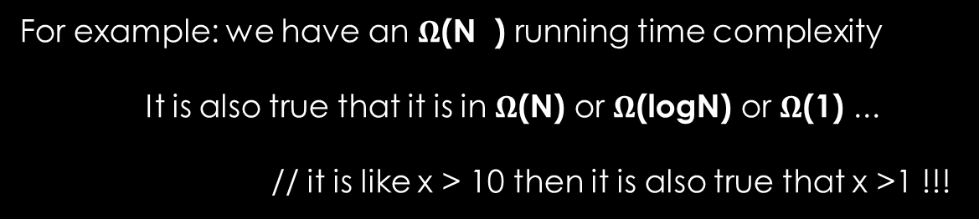
2
For example: we have an $Ω$(N ) running time complexity
It is also true that it is in $Ω$(N) or $Ω$(logN) or $Ω$(1) ...
// it is like x > 10 then it is also true that x >1 !!!

Slide 21
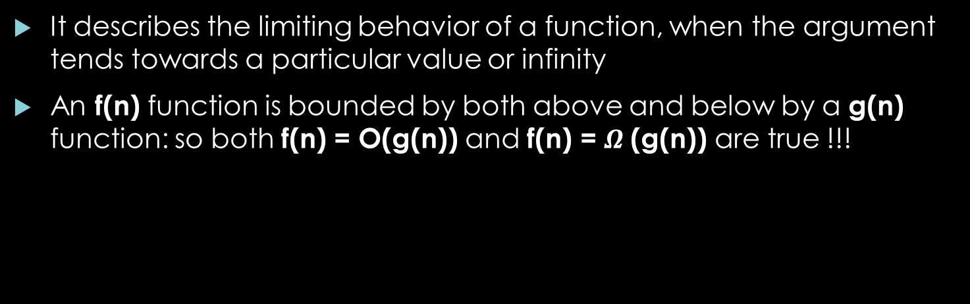

The big theta notation ( $θ$ )
It describes the limiting behavior of a function, when the argument tends towards a particular value or infinity
An f(n) function is bounded by both above and below by a g(n) function: so both f(n) = O(g(n)) and f(n) = $Ω$(g(n)) are true !!!
The f(n) =$θ$( g(n) ) expression means, that there is some c1,c2>0 values and some n > 0
threashold value → such that for n > n the c1 * | g(n) | > | f(n) | > c2 *| g(n) |
0
0
-
-

Slide 22
The f(n) =$θ$( g(n) ) expression means, that there is some c1,c2>0 values and some n > 0
threashold value → such that for n > n the c1 * | g(n) | > | f(n) | > c2 *| g(n) |
0
0
-
-
c1 * g(n)
y(n)
f(n)
c2 * g(n)
n
n
0

Slide 24
Examples
2
f(n) = 3n – 100n + 6

Slide 25
Examples
2
f(n) = 3n – 100n + 6
2
1.) Let’s prove, that f(n) = O(n )

Slide 26
Examples
2
f(n) = 3n – 100n + 6
2
1.) Let’s prove, that f(n) = O(n )
Definition for O → | f(n) | < c * | g(n) |
If n is large, we can get rid of the absolute values, we have to make sure
that 3n > 100n
-
2
-

Slide 27
Examples
2
f(n) = 3n – 100n + 6
2
1.) Let’s prove, that f(n) = O(n )
Definition for O → | f(n) | < c * | g(n) |
If n is large, we can get rid of the absolute values, we have to make sure
that 3n > 100n
So if n > n = 34 → we can get rid of the absolute values → | f(n) | = f(n)
3n – 100n + 6 < c * n
If: c = 3 and n0 = 34 it is going to be ok because 3n - 100n + 6 < 3n
-
2
-
0
2
2
-
2
2
-

Slide 28
Examples
2
f(n) = 3n – 100n + 6
3
2.) Let’s prove, that f(n) = O(n )
Definition for O → | f(n) | < c * | g(n) |
If n is large, we can get rid of the absolute values, we have to make sure
that 3n > 100n
So if n > n = 34 → we can get rid of the absolute values → | f(n) | = f(n)
3n – 100n + 6 < 3n < n
If: c = 1 and n0 = 34 it is going to be ok
-
2
-
0
2
2
3
-
-

Slide 30
Examples
2
f(n) = 3n – 100n + 6
k
k+i
IMPORTANT: if f(n) = O(n ) then f(n) = O(n ) where i>1 because
big O is an upper bound for a given f(n) function !!!
2
For example: bubble sort has O(N ) running time complexity
It is also true that bubble sort is in O(N ) or O(N ) or O(N ) ...
3
4
5

Slide 31
Examples
2
f(n) = 3n – 100n + 6
|
3.) Let’s prove, that f(n) = O(n)
Definition for O → | f(n) | < c * | g(n) |
If n is large, we can get rid of the absolute values, we have to make sure
that 3n > 100n
So if n > n = 34 → we can get rid of the absolute values → | f(n) | = f(n)
f(n) < c*n → 3n – 100n + 6 < c * n
We have already come to the consclusion that 3n – 100n + 6 > n if n > n0
So: c * n > n which is not feasible !!!
-
2
-
0
2
-
-
2
2
-
2
-

Slide 32

Examples
2
f(n) = 3n – 100n + 6
2
3.) Let’s prove, that f(n) = $Ω$(n )
Definition: | f(n) | > c * | g(n) |
So if n > n = 34 → we can get rid of the absolute values → | f(n) | = f(n)
f(n) > c*n → 3n – 100n + 6 > c * n = 1 * n
So: c=1 and n0 = 34 then it is going to be a lower bound which is omega
-
0
2
2
2
2
-

Slide 33

Examples
2
f(n) = 3n – 100n + 6
2
3.) Let’s prove, that f(n) = $Ω$(n )
So if n > n = 34 → we can get rid of the absolute values → | f(n) | = f(n)
f(n) < c*n → 3n – 100n + 6 > c * n = 1 * n
So: c=1 and n0 = 34 then it is going to be a lower bound which is omega
0
2
2
2
-
2
2
2
And because f(n) = O(n ) and f(n) = $Ω$(n ) → f(n) = $θ\left(n \right)$ !!!!

Slide 34
Examples
k
f(n) = a n + .... + a n + a
k
1
0
k
If we have an expression like this, it is going to be an $θ\left(n \right)$ !!!

Slide 36
Algorithms running time
O(n!) factorial
complexity
n
f(n)
O( c ) exponential complexity
// c is a constant
k
O( n ) polinomial complexity
// k > 1
O(N*logN) linearithmic complexity
O(N) linear time complexity
O(logN) logarithmic complexity
n
O(1) constant time complexity

Slide 37
Algorithms running time
Constant time complexity O(1) swapping two numbers or deciding whether
a number is odd or even
function swapNums(num1, num2):
temp = num1
num1 = num2
num2 = temp
end function
Logarithmic time complexity O(logN)
- finding an arbitrary item in a SORTED array
- check whether there is a cycle in a graph when solving
Kruskal-algorithm ( with disjoint sets )

Slide 38
Algorithms running time
Linear time complexity O(N) finding the maximum value in
an array of numbers
function findMax(a[])
max = a[0]
for(int i=0;i<a.length;++i):
if( a[i] > max ):
max = a[i]
return max
end function
Linearithmic time complexity O(N*logN)
- mergesort, quicksort, heapsort
- finding closest pair of points with divide and conquer method

Slide 39
Algorithms running time
k
Polinomial time complexity O( N ) where k = 2 „quadratic”
- bubble sort, insertion sort
- finding closest pair of points with brute force approach
Exponential time complexity O( c ) where c is a constant
- towers of Hanoi problem ~ c=2 here in this case
- calculating fibonacci numbers with recursive
manner ~ c=2 here too
- travelling salesman problem with dynamic programming
implementation
Factorial time complexity O(N!)
- solving the travelling salesman problem with
brute force search
// we generate all the possible routes which is N! and
try to find the one with the minimum overall distance
N

Slide 41
Complexity classes
complexity
P
NP
NP hard
NP complete

Slide 42
Complexity classes
NP
P
NP-complete
NP hard

Slide 43
P complexity class
P stands for polynomial
Precise definition: all the decision problems that can be solved with deterministic Turing-machines using polynomial amount of computational time
These problems are efficiently solvable but not all of these problems have a practical solutions
For example: bubble sort is in P but usually we use mergesort for sorting problems

Slide 44
NP complexity class
NP stands for nondeterministic polynomial
If we have a certain solution for the problem: we can verify this solution in polynomial time
P is in NP: it is true for the problems in P that we can verify the solution in polynomial time //we can even solve it in polynomial time
One of the most important problems: P = NP ?
For example: integer factorization. Very hard to solve the problem, but if we have the solutions x and y, we can verify it by multiplying the two numbers x*y which is a polynomial procedure
TSP: if we have the solution route, we can make sure it satisfies the conditions in polynomial time

Slide 45
NP-complete complexity class
The hardest problems in NP
We can transform an NP-complete problem into an NP problem in polinomial time „Karp reduction”
Important in computer science: if we manage to find a polynomial algorithm for an NP-complete problem, it means P = NP
This is why it is important complexity class !!!
If we know the solution: it is easy to verify it in polynomial time
That is, the time required to solve the problem using any currently known algorithm increases very quickly as the size of the problem grows
For example: graph coloring, Hamiltonian path problem

Slide 46
NP-hard complexity class
Problems that are at least as hard as the problems in NP class
We can transform an NP-hard problem into an NP-complete problem in polinomial time „Karp reduction”
For example: halting problem
  This is the problem which asks „given a program and the input, will it run forever?” Yes/no question, so a decision problem

Slide 47
Complexity classes
NP
P
NP-complete
NP hard

Slide 49
Analyzing loops

Slide 50
Constant time complexity: O(1)
Swapping two numbers or deciding whether a number
is even or odd
function swap(num1, num2):
temp = num1;
num1 = num2;
num2 = temp;

Slide 51
Linear running time: O(N)
When we have a for loop
+ inside the loop we make O(1) running time operations
for i=0 to N:
do O(1) operation
For example: we sum up items, or we check whether an
item is equal to 10
// searching in 1 dimensional array

Slide 52
2
Quadratic running time: O(N )
When we have a for loop
+ we have a nested for loop
+ inside the loop we make O(1) running time operations
for i=0 to N:
for j=0 to N:
do O(1) operation
For example: we sum up items, or we check whether an
item is equal to 10
// searching in 2 dimensional array
for i=0 to N:
for j=0 to i:
do O(1) operation
Here we make fewer operations but still quadratic !!!

Slide 53
k
Polinomial running time: O(N )
Basically the number of nested for loops is a good
indicator for the running time complexity !!!

Slide 55
Linear search
We have an array of unsorted items / integers
We want to find a given item
If we know the index of the item → we can get it in O(1) constant time complexity
But usually we do not know the index, so we have to iterate through the array + make checks
Input size: number of items in the array

Slide 56
12
2
6
8
1
-5
22
68
7
0

Slide 57
find(12)
12
2
6
8
1
-5
22
68
7
0

Slide 58
find(12)
12
2
6
8
1
-5
22
68
7
0

Slide 59
find(12)
12
2
6
8
1
-5
22
68
7
0

Slide 60
find(12)
12
2
6
8
1
-5
22
68
7
0
This is the best-case scenario for linear search
~ the first item is the one we are looking for
O(1) running time

Slide 61
find(10)
12
2
6
8
1
-5
22
68
7
0

Slide 62
find(10)
12
2
6
8
1
-5
22
68
7
0

Slide 63
find(10)
12
2
6
8
1
-5
22
68
7
0

Slide 64
find(10)
12
2
6
8
1
-5
22
68
7
0

Slide 65
find(10)
12
2
6
8
1
-5
22
68
7
0

Slide 66
find(10)
12
2
6
8
1
-5
22
68
7
0

Slide 67
find(10)
12
2
6
8
1
-5
22
68
7
0

Slide 68
find(10)
12
2
6
8
1
-5
22
68
7
0

Slide 69
find(10)
12
2
6
8
1
-5
22
68
7
0

Slide 70
find(10)
12
2
6
8
1
-5
22
68
7
0

Slide 71
find(10)
12
2
6
8
1
-5
22
68
7
0
This is the worst-case scenario
~ we have considered every item in the array
without any result
O(N) running time

Slide 72
12
2
6
8
1
-5
22
68
7
0
average-case scenario
The items we are looking for is uniformly distributed from the first
index to the last index
~ on average we have to make N/2 steps
to find the item we are looking for
O(N) running time

Slide 74
Binary search
Again, we want to find an item in an array
This time the array is sorted !!!
If we know the index of the item → we can get it with O(1) constant time complexity
If we don’t know the index → we can start at the middle, on every iteration we can discard half the items

Slide 75
12
22
23
34
56
67
76
89
95
97

Slide 76
find(22)
12
22
23
34
56
67
76
89
95
97

Slide 77
find(22)
12
22
23
34
56
67
76
89
95
97

Slide 78
find(22)
12
22
23
34
56
67
76
89
95
97

Slide 79
find(22)
12
22
23
34
56
67
76
89
95
97

Slide 80
find(22)
12
22
23
34
56
67
76
89
95
97

Slide 81
find(22)
12
22
23
34
56
67
76
89
95
97

Slide 82
find(22)
12
22
23
34
56
67
76
89
95
97

Slide 83

find(22)
12
22
23
34
56
67
76
89
95
97
What is the running time of this algorithm?
How many times can we divide N by 2 until we have 1?
1 = $\frac{N}{2^{x}}$

Slide 84
find(22)
12
22
23
34
56
67
76
89
95
97
What is the running time of this algorithm?
How many times can we divide N by 2 until we have 1?
1 = $\frac{N}{2^{x}}$

Slide 85


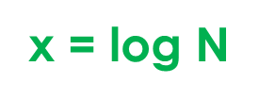

1 = $\frac{N}{2^{x}}$
$2^{x}$ = N
log $2^{x}$ = log N
x = log N
So we have come to the conclusion that binary search
has O(logN) logarithmic running time
What does it mean?
If we have 4x larger array → algorithm has 2x running time
If we have 9x larger array → algorithm has 3x running time

